Slide 1

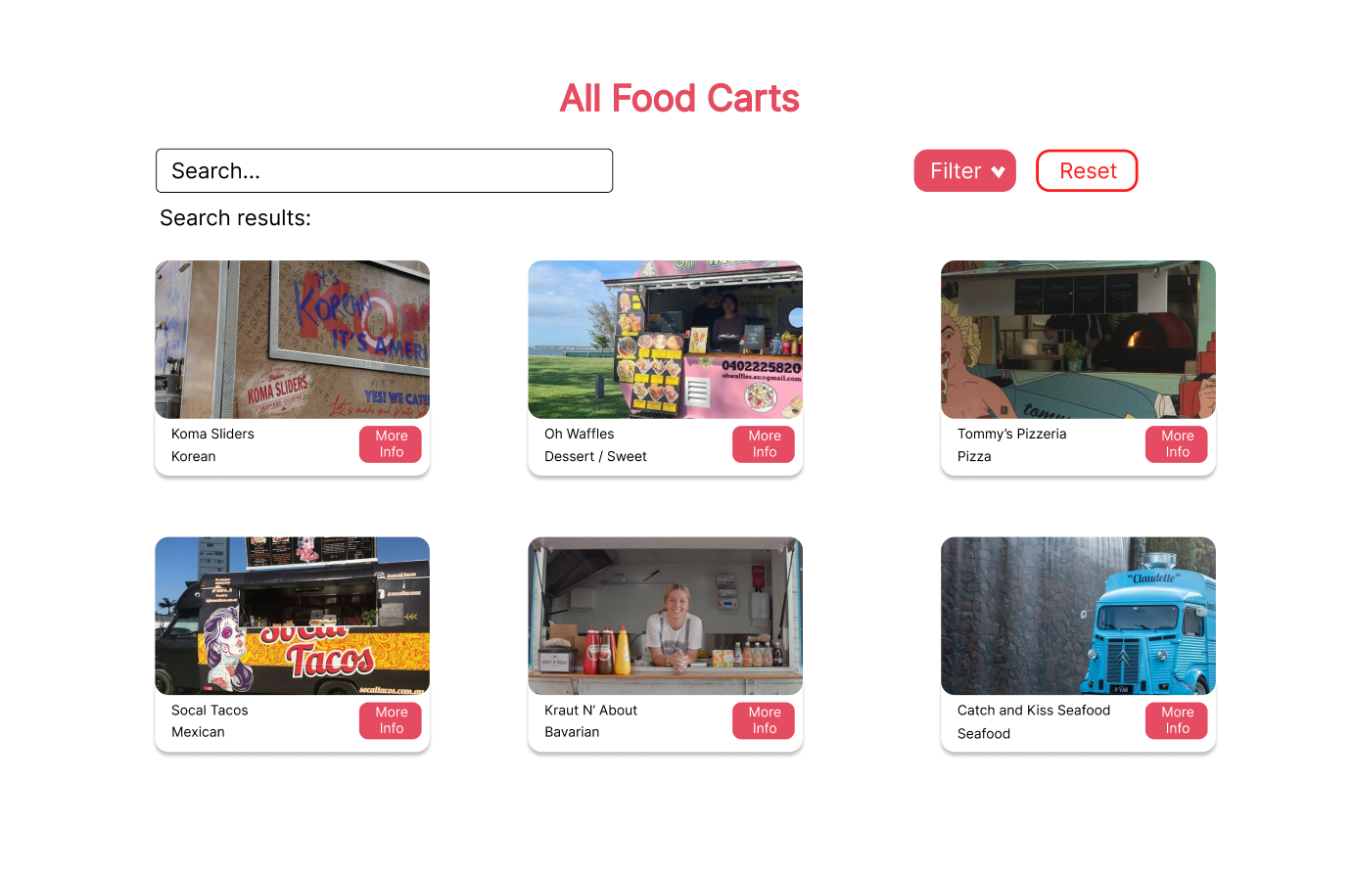
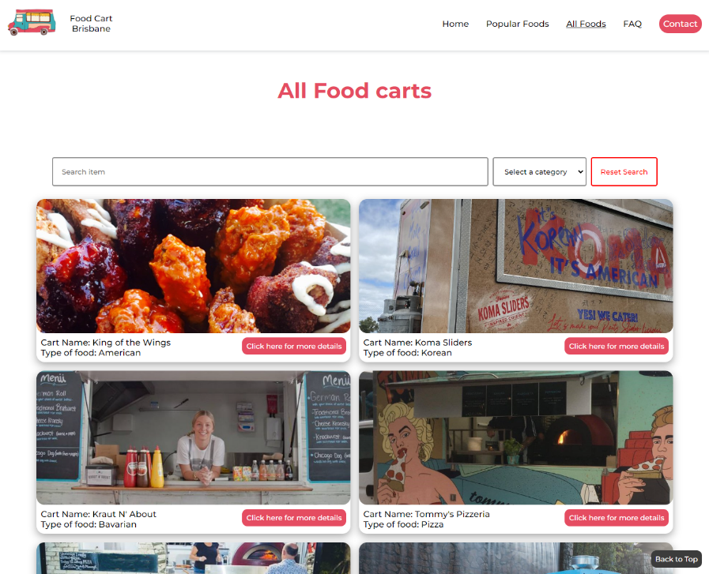
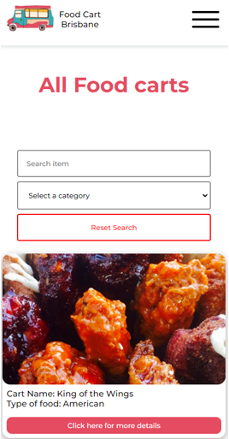
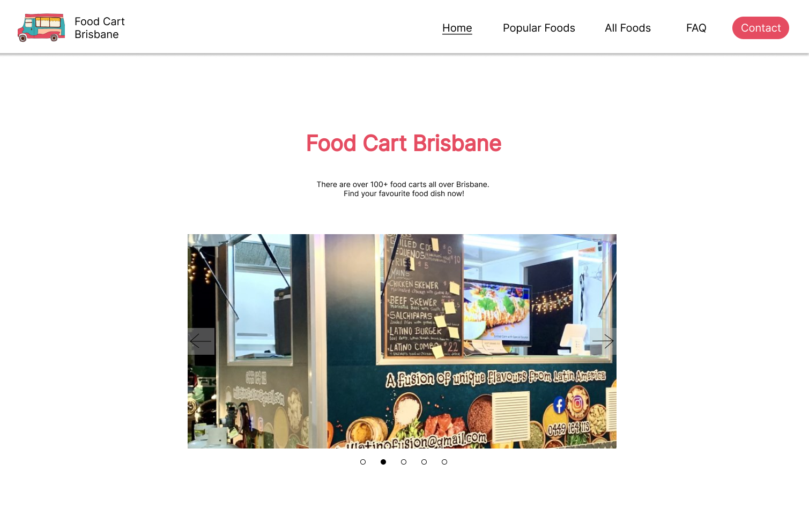
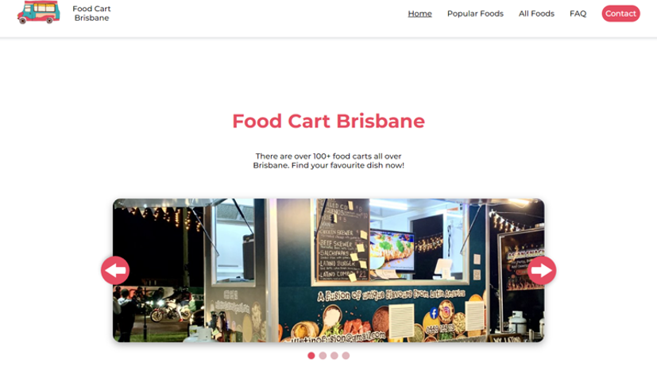
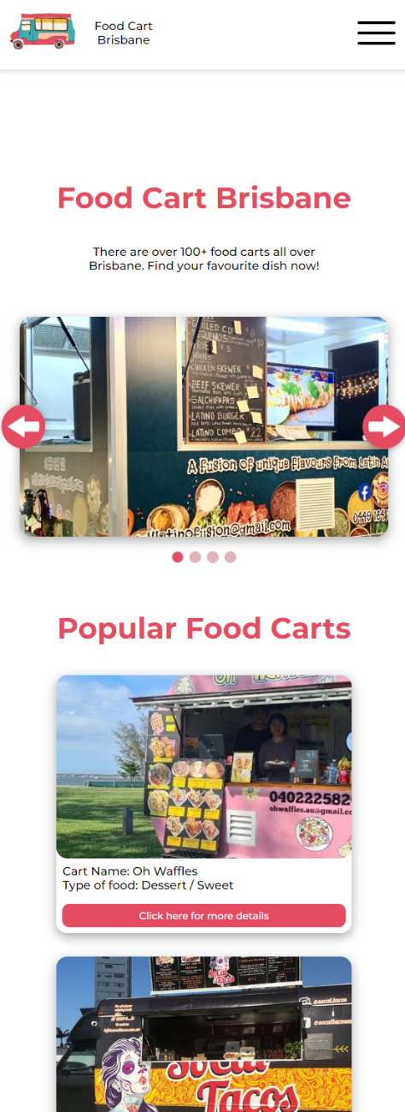
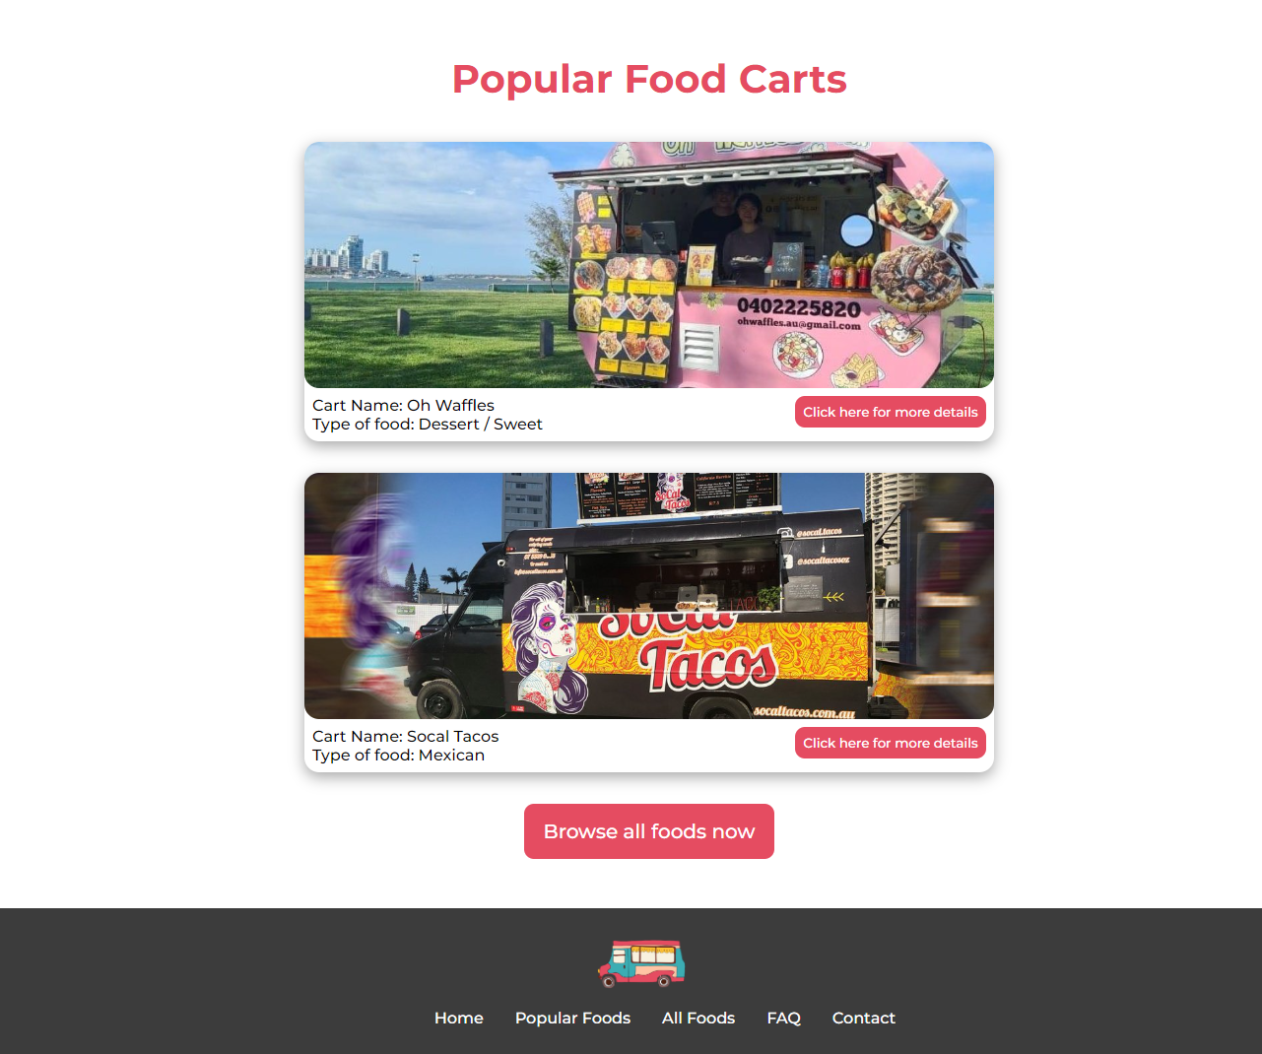
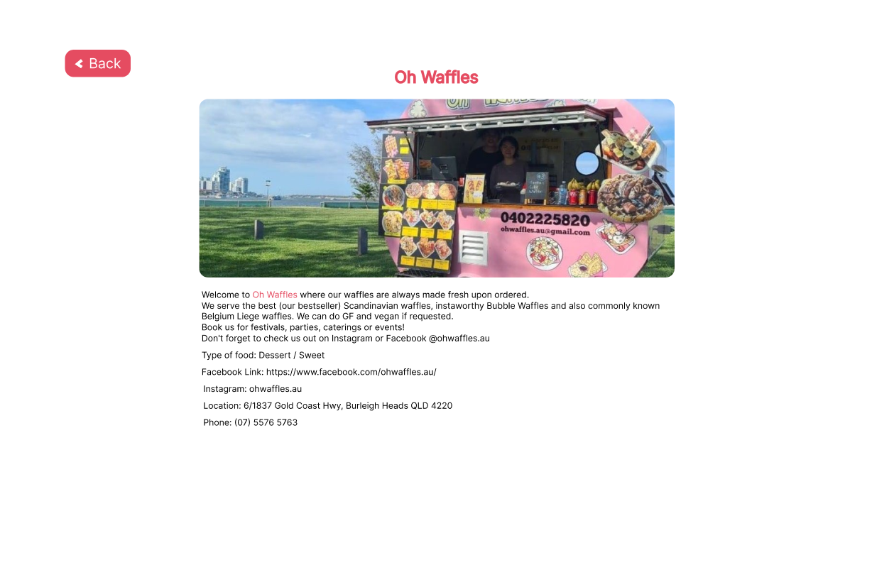
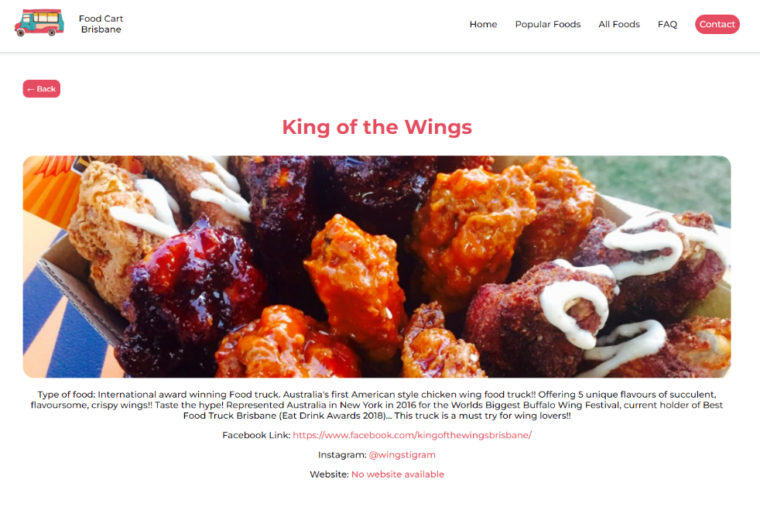
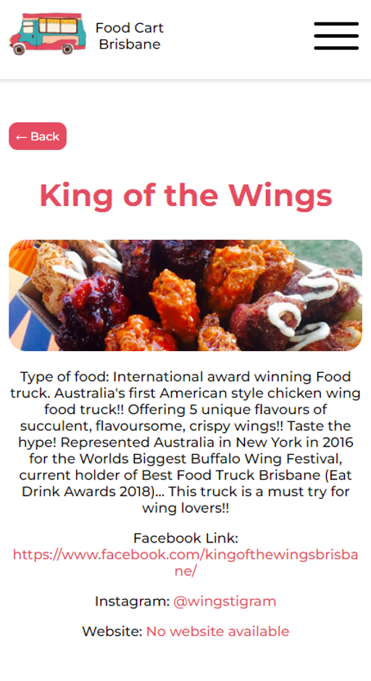
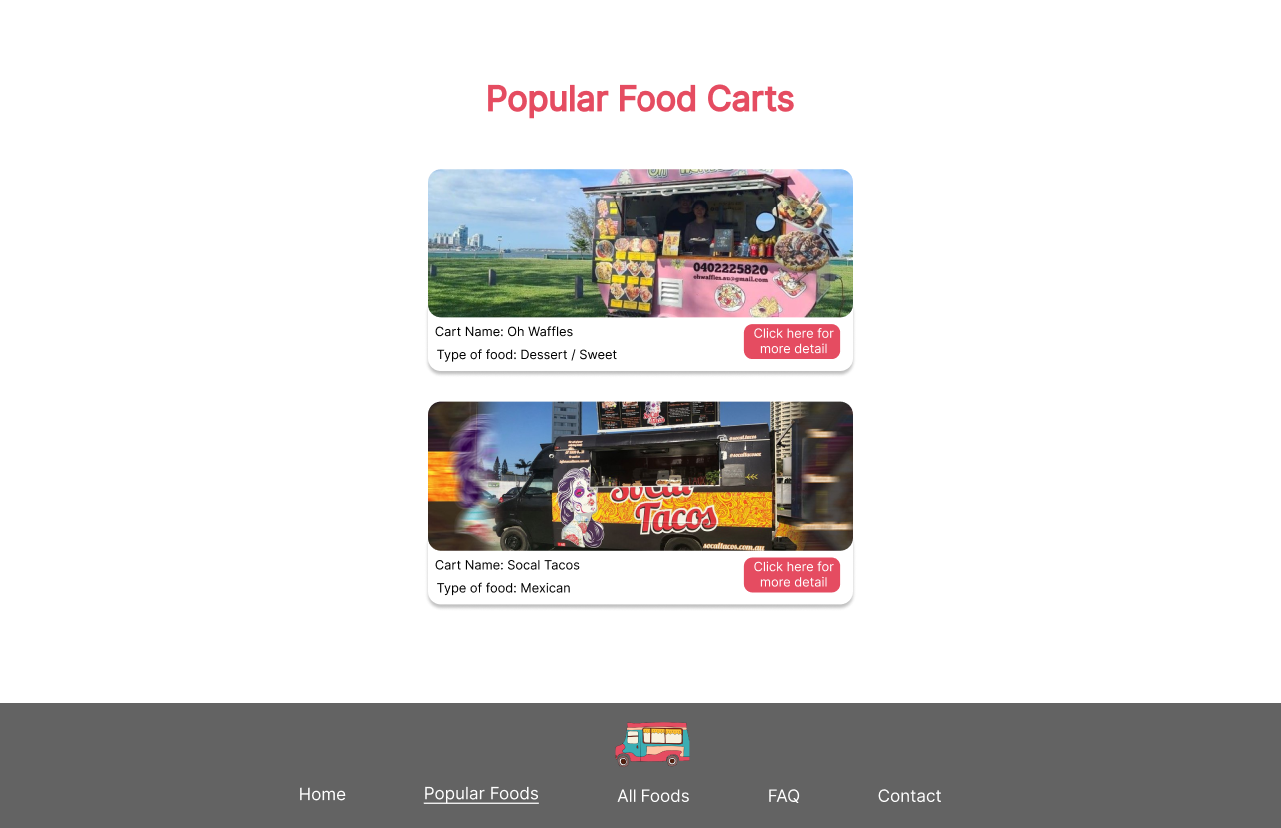
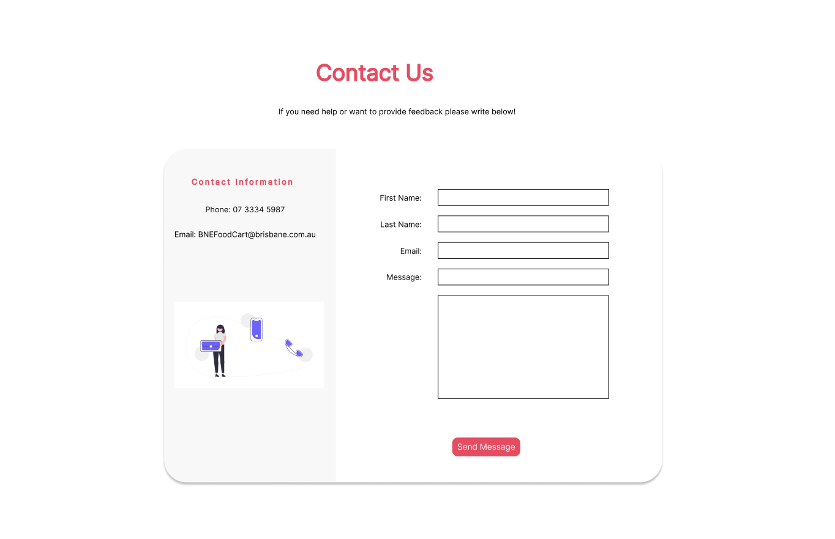
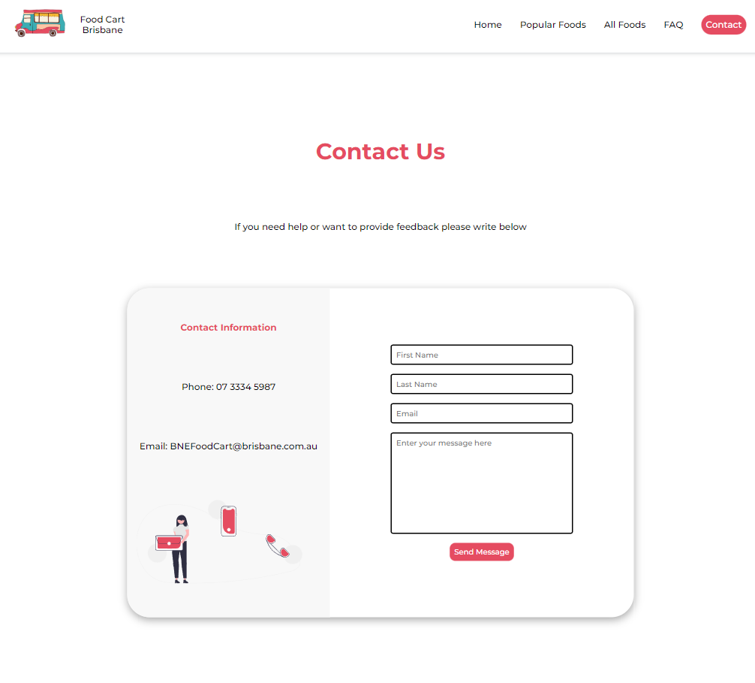
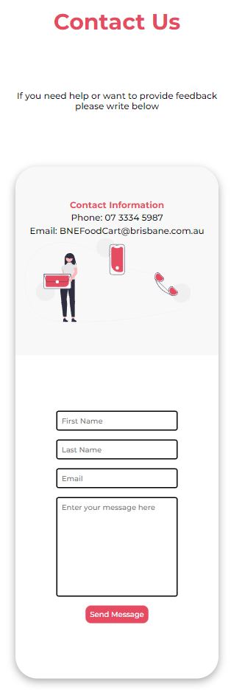
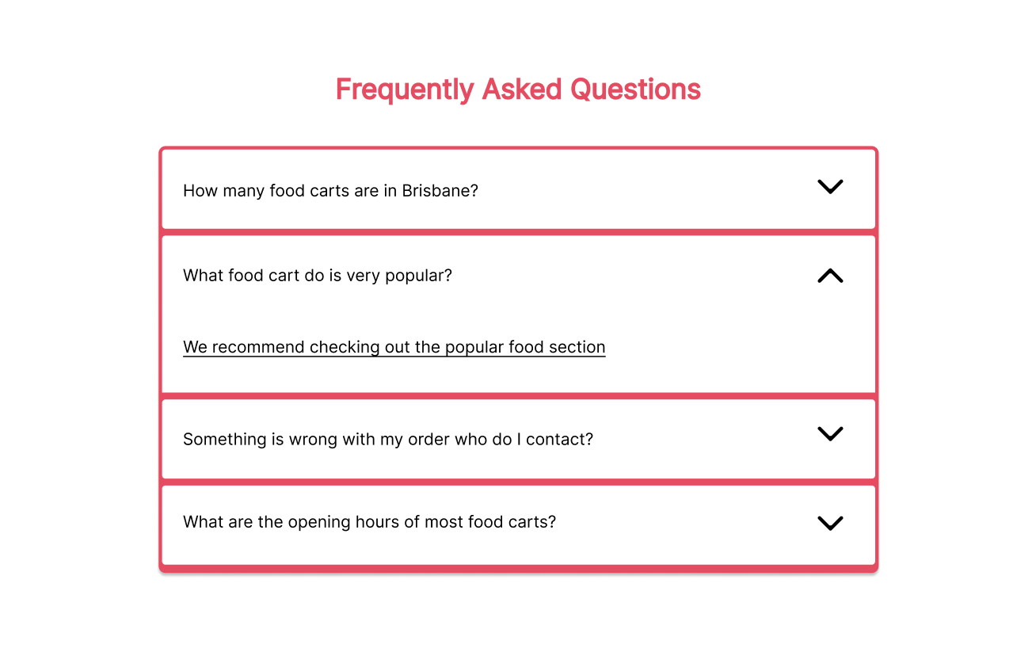
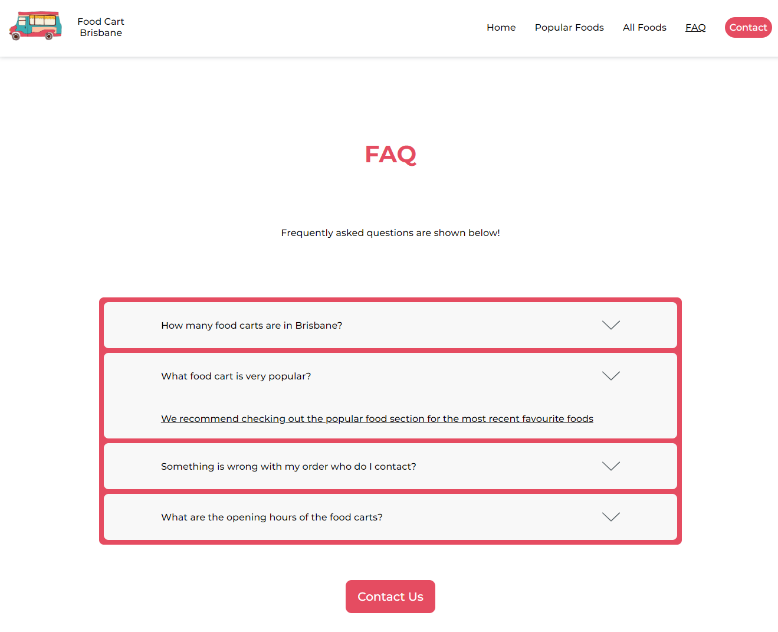
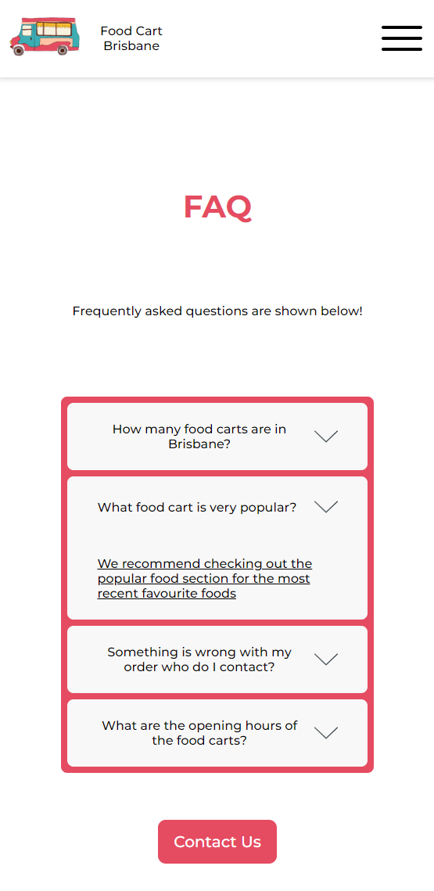
DECO1400 Website Design Poster – Food Cart Brisbane
Tahseen Islam 45808609
Live View: deco-1400-project.vercel.app
Summary of the project
Lessons I learned and what I would do to improve the website in future
2
Usability #1, #6 & #7 – Current filter and search is shown so the user knows what is selected
This website display all food carts around Brisbane and users can search or filter their favorite cuisine. The website is created using HTML, CSS and JavaScript and features 5 HTML pages, a single CSS file that contains all styling and various JS files that allow for interactivity throughout the website such as: Interacting with the slideshow, showing a detailed view of a food cart, searching and filtering a food cart, accordion and contact form.
I have learned how to create a website from scratch using HTML, CSS and JavaScript and learned many crucial concepts such as asynchronous functions to call APIs and using JavaScript to dynamically render HTML elements. I also learned how to use various JavaScript Array methods such as .map, .filter to be able to implement the search and filter sections. I also learned how to use localStorage to store the truck id of the food cart that I would like to know more about.
In the future I would like to expand on the expanded details page. The API does not include the current location of the food cart so I was not able to add that information, but I will figure out a way to find the location and show it in Google Maps. I would also add a backend to allow for the contact form to work and I am able to receive messages sent from the website.
Hi-Fi Prototype All Food Page
All Food Page - Desktop view (left) and mobile view (right)
Evaluation of the website based on usability heuristics
I believe this website is very good as it follows all 10 usability heuristics. They are shown in textboxes below.
1
Usability #1 – Current page is underlined to show user what page they are on
Home Page - Desktop view (left) and mobile view (right)
Hi-Fi Prototype Home Page
Usability #4, #6 & #9 – If no search result is found, the user will be notified that there are no food carts matching the search criteria
Usability #7 – All images are lazy loaded for efficient browser load time
Usability #3 – User can reset filter and search if needed
3
Hi-Fi Prototype Detailed Food Cart Page
Usability #3 – User can easily go back to previous page
Detailed Food Cart Page - Desktop view (left) and mobile view (right)
Usability #8– Max-width set so food cart image does not stretch on larger screens.
Usability #2 & #4 – Flow of page is logical where navbar is at top, content in the middle and footer at the bottom
Usability #2 – Written in simple words so everyone can understand easily
Usability #4 – Links open in new tab in case user wants to continue browsing on this page
5
Hi-Fi Prototype Contact Page
Contact Page - Desktop view (left) and mobile view (right)
4
Usability #10 – User is provided helpful documentation with common questions and answers
Hi-Fi Prototype FAQ Page
FAQ Page - Desktop view (left) and mobile view (right)
Usability #6 – User can see exactly what they have types for the input sections
Usability #4 – Familiar contact form pattern
Usability #5 & #9 – Error checking prevents submitting without filling required information such as email as well as checking for a valid email
Usability #8 – Button appearance changes based on hover and cursor changes to pointer alerting user the button is clickable

